Slide 1
MGB235 Monitoring and Managing Operational Performance
Week 3
Operations Strategy and Measuring Performance
Unit Coordinator: Dr Kavoos Mohannak

Slide 2
Learning Objectives
Organisational and operational strategy & goals
The linkage between organisational, operational strategy(s) & performance measurement systems for products, both goods and services
Measurement systems & Decision Making
Measuring the performance of Goods (key indicators)
Designing measurement/performance systems for operations
Measuring performance across the whole supply chain
Corporate social responsibility and performance measurement

Slide 3
A reminder:
This unit is concerned with an understanding of the design and management of the operations functions of an organisation. Unless the various elements of the value chain have been designed in an appropriate way, then there can serious consequences to the overall profit levels of the organisation.
e.g. Are issues arising due to systemic problems, processes, individual problems or problems with individuals?
It is often easy to place the blame for a product delivery with the person delivering it – when often it is the design of the operating system being used to produce & deliver the product which needs improving.

Slide 4
Businesses Compete Using Operations
Product and service design
Cost
Location
Quality
Quick response
Flexibility
Inventory management
Supply chain management
Service
Managers and workers
2-4

Slide 5
Why Some Organizations Fail
Neglecting operations strategy
Failing to take advantage of strengths and opportunities and/or failing to recognize competitive threats
Too much emphasis on short-term financial performance at the expense of R&D
Too much emphasis on product and service design and not enough on process design and improvement
Neglecting investments in capital and human resources
Failing to establish good internal communications and cooperation
Failing to consider customer wants and needs
2-5

Slide 6
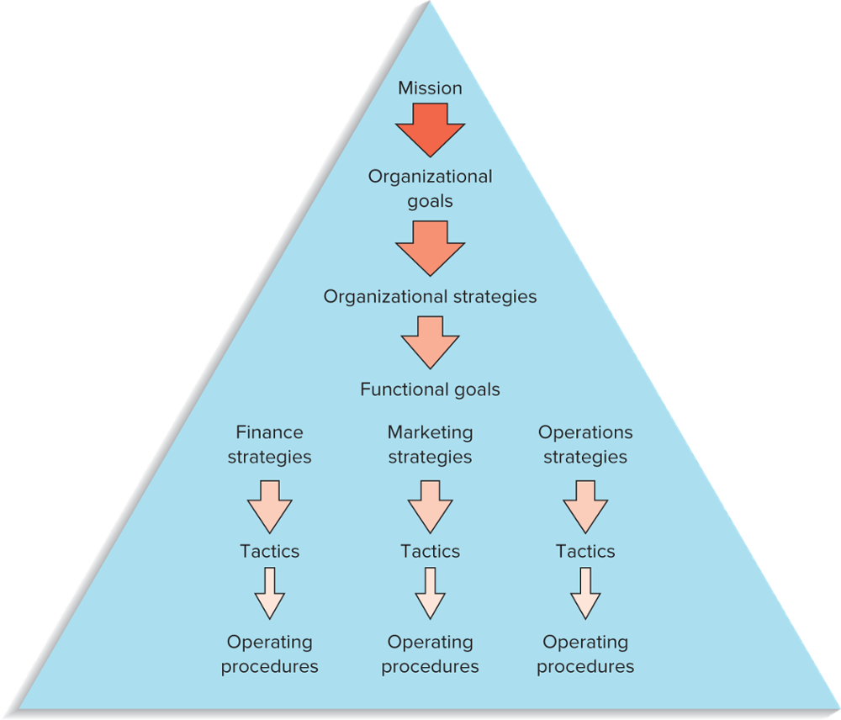
Hierarchical Planning
Mission
Goals
Organizational strategies
Functional strategies
Tactics
FIGURE 2.1
Planning and decision making are hierarchical in organizations
2-6

Slide 7
Organisational Goals
The mission statement serves as the basis for organizational goals
Goals
Provide detail and the scope of the mission
Goals can be viewed as organisational destinations
Goals serve as the basis for organisational strategies
Copyright ©2021 McGraw-Hill Education. All rights reserved. No reproduction or distribution without the prior written consent of McGraw-Hill Education.
2-7

Slide 8
Different Levels of Strategies
Strategy
A plan for achieving organizational goals
Serves as a roadmap for reaching the organizational destinations
Organizations have
Organizational strategies
Overall strategies that relate to the entire organization
Support the achievement of organizational goals and mission
Functional level strategies
Strategies that relate to each of the functional areas and that support achievement of the organizational strategy
Copyright ©2021 McGraw-Hill Education. All rights reserved. No reproduction or distribution without the prior written consent of McGraw-Hill Education.
2-8

Slide 9
Mission and Strategies
Supply Chain Strategy
How the organization should work with suppliers and policies relating to customer relationships and sustainability
Sustainability Strategy
Work with governmental regulations and interest groups to achieve sustainability goals
Global Strategy
Work with international suppliers/producers and also with countries where the products and services are sold
Operations strategy
The approach, consistent with organization strategy, that is used to guide the operations function
2-9

Slide 10
Tactics and Operations
Tactics
The methods and actions taken to accomplish strategies
The “how to” part of the process
Operations
The actual “doing” part of the process
Copyright ©2021 McGraw-Hill Education. All rights reserved. No reproduction or distribution without the prior written consent of McGraw-Hill Education.
2-10

Slide 11
Sample Operations Strategies
Organizational Strategy | Operations Strategy | Examples of Companies or Services
Low Price | Low cost | U.S. first-class postage Wal-Mart
Responsiveness | Short processing times On-time delivery | McDonald’s restaurants FedEx
Differentiation: High Quality | High performance design and/or high quality processing Consistent quality | Sony TV Coca-Cola
Differentiation: Newness | Innovation | 3M, Apple
Differentiation: Variety | Flexibility Volume | Burger King (Have it your way”) McDonald’s (“Buses Welcome”)
Differentiation: Service | Superior customer service | Disneyland IBM
Differentiation: Location | Convenience | Supermarkets; mall stores
2-11

Slide 12
What is the linkage between organisational, operational strategy(s) & performance measurement systems

Slide 13
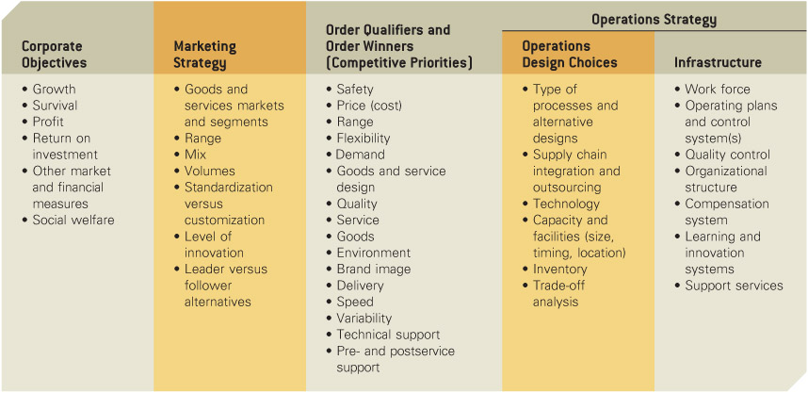
Hill’s Strategy Development Framework
(links between organisationl and operational strategies)
Source: T. Hill, Manufacturing Strategy: Text and Cases, 2nd ed., Burr Ridge, IL: Irwin Publishers, 1994, p. 28

Slide 14
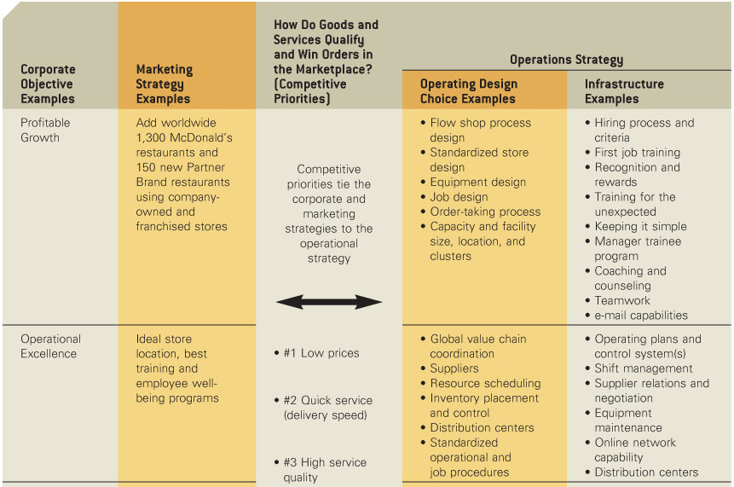
Applying the Hill’s Strategy Development Framework to McDonald’s (slide 1)

Slide 15
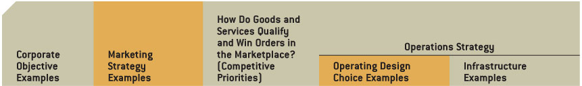
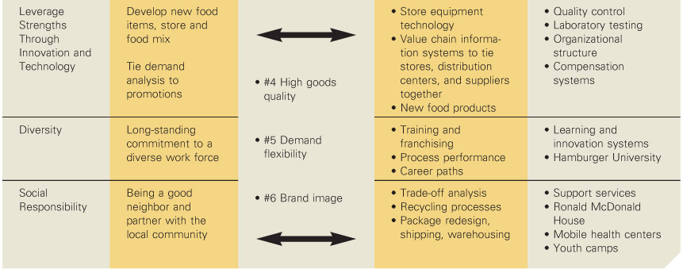
Applying the Hill’s Strategy Development Framework to McDonald’s (slide 2)

Slide 16
Strategic OM Decision Areas
Decision Area | What the Decisions Affect
Product and service design | Costs, quality, liability, and environmental issues
Capacity | Cost, structure, flexibility
Process selection and layout | Costs, flexibility, skill level needed, capacity
Work design | Quality of work life, employee safety, productivity
Location | Costs, visibility
Quality | Ability to meet or exceed customer expectations
Inventory | Costs, shortages
Maintenance | Costs, equipment reliability, productivity
Scheduling | Flexibility, efficiency
Supply chains | Costs, quality, agility, shortages, vendor relations
Projects | Costs, new products, services, or operating systems
Copyright ©2021 McGraw-Hill Education. All rights reserved. No reproduction or distribution without the prior written consent of McGraw-Hill Education.
2-16

Slide 17
Quality-Based Strategies
Quality-based strategy
Strategy that focuses on quality in all phases of an organization
Pursuit of such a strategy is rooted in a number of factors:
Trying to overcome a poor quality reputation
Desire to maintain a quality image
A desire to catch up with the competition
A part of a cost reduction strategy
2-17

Slide 18
Time-Based Strategies
Time-based strategies
Strategies that focus on the reduction of time needed to accomplish tasks
It is believed that by reducing time, costs are lower, quality is higher, productivity is higher, time-to-market is faster, and customer service is improved
2-18

Slide 19
Time-Based Strategies (cont.)
Areas where organizations have achieved time reductions:
Planning time
Product/service design time
Processing time
Changeover time
Delivery time
Response time for complaints
2-19

Slide 20
Agile Operations
Agile operations
A strategic approach for competitive advantage that emphasizes the use of flexibility to adapt and prosper in an environment of change
Involves the blending of several core competencies:
Cost
Quality
Reliability
Flexibility
Copyright ©2021 McGraw-Hill Education. All rights reserved. No reproduction or distribution without the prior written consent of McGraw-Hill Education.
2-20

Slide 21
The Balanced Scorecard Approach (relates to Assessment 1)
A top-down management system that organizations can use to clarify their vision and strategy and transform them into action
Develop objectives
Develop metrics and targets for each objective
Develop initiatives to achieve objectives
Identify links among the various perspectives
Finance
Customer
Internal business processes
Learning and growth
Monitor results
Copyright ©2021 McGraw-Hill Education. All rights reserved. No reproduction or distribution without the prior written consent of McGraw-Hill Education.
2-21

Slide 22
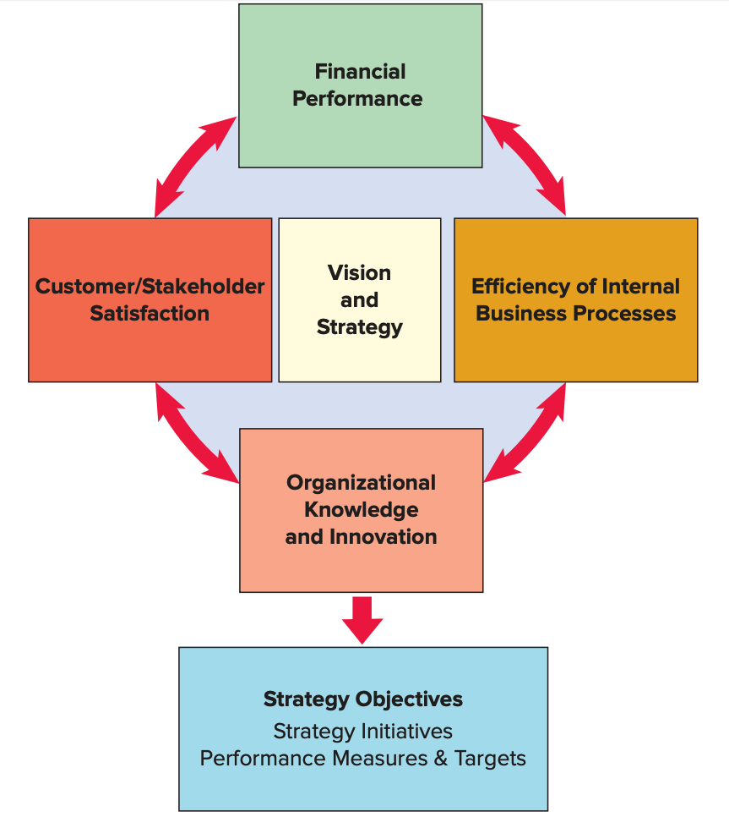
The Balanced Scorecard
The Balanced Scorecard
Source: Adapted from Robert S. Kaplan and David P. Norton, “Using the Balanced Scorecard as a Strategic Management System,” Harvard Business Review (January-Febrary 1996): 76.
2-22

Slide 23
Performance Measures
A key point with performance management is the saying: ‘what gets measured gets done’
That is, what the organisation chooses to use as performance measure(s) is what staff will concentrate on.
The measurement-improve-reward cycle one way we can invoke change in an organisation
Levels of performance measurement
Individual
Group
Section/department
Organisation
Etc.

Slide 24
What are the specific performance measures used
where you work?
QUESTION: Do you need measures to evaluate a company’s (or section’s) performance in relation to goods and services?
If so:
What do you measure?
How do you measure it?
How frequently should you measure it?
Who should measure it?

Slide 25
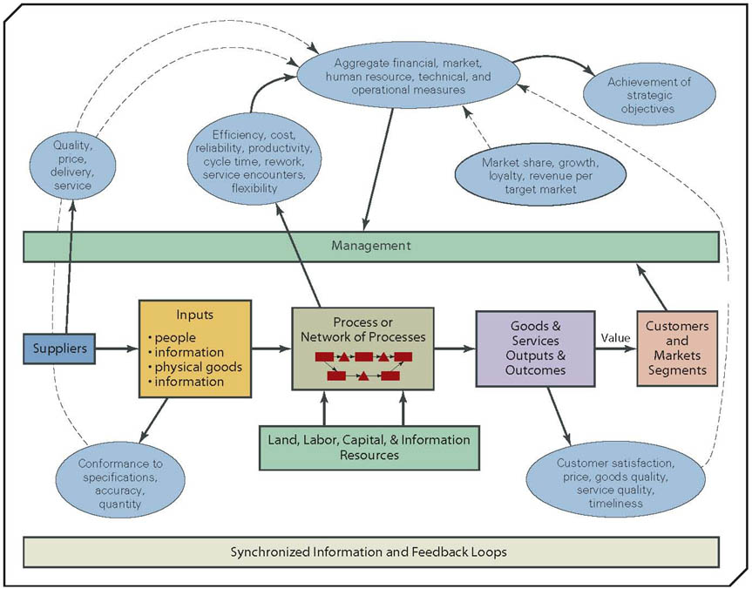
Examples of Value Chain Performance Measurements

Slide 26
Emphasis on decision making
“Good decisions are facilitated through measurement”
“Measurement provides an objective basis for making decisions”
BUT:
Is the measurement objective?
How should we measure overall organisational performance, and how does measurement relate to operations?
How should we measure the performance of goods?
How should we measure the performance of services?
How should we measure the performance of processes throughout the whole value chain (the system)?

Slide 27
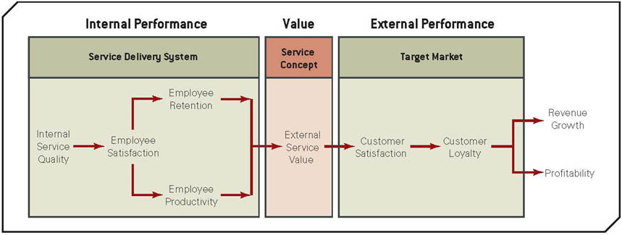
Is the measurement objective?
Source: Adapted from J. L. Heskett, T. O. Jones, G. W. Loveman, W. E. Sasser, Jr., Jr., and L. A. Schlesinger, “Putting the Service-Profit Chain to Work,” Harvard Business Review, March–April 1994, pp. 164-174.
The Service-Profit Chain Model

Slide 28
How should we measure the performance of goods?
What does measurement mean in Operations?
…the act of quantifying the performance criteria (metrics, standards) of organisational units, goods and services, processes, people, and other business activities (Collier and Evans, 2007, 72)

Slide 29
Different categories of performance measures:
Financial
Customer and market
Safety
Quality
Time
Flexibility
Innovation and learning
Productivity

Slide 30
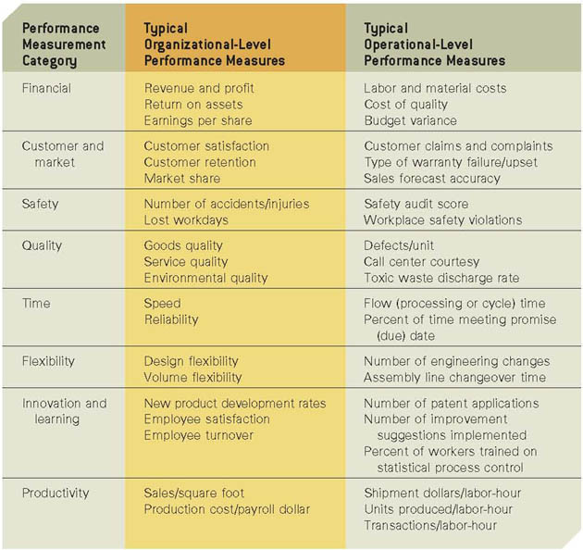

Slide 31
Example: Measuring Productivity
Productivity
A measure of the effective use of resources, usually expressed as the ratio of output to input
Productivity measures are useful for
Tracking an operating unit’s performance over time
Judging the performance of an entire industry or country
Copyright ©2021 McGraw-Hill Education. All rights reserved. No reproduction or distribution without the prior written consent of McGraw-Hill Education.
2-31

Slide 32
Productivity Measures
2-32

Slide 33
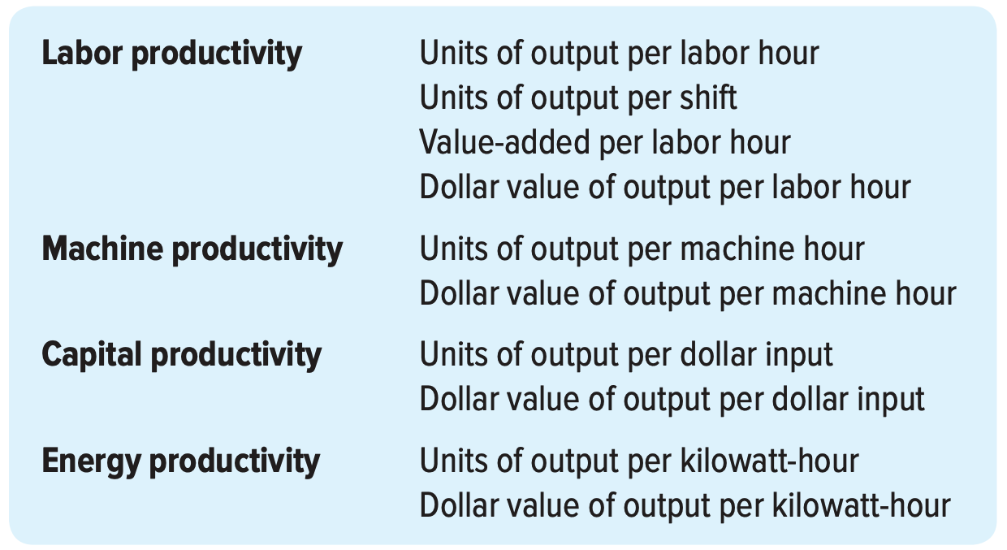
Some examples of partial productivity measures
Copyright ©2021 McGraw-Hill Education. All rights reserved. No reproduction or distribution without the prior written consent of McGraw-Hill Education.
2-33

Slide 34
Productivity Calculation Example
Units produced: 5,000
Standard price: $30/unit
Labor input: 500 hours
Cost of labor: $25/hour
Cost of materials: $5,000
Cost of overhead: 2× labor cost
What is the multifactor productivity?
Copyright ©2021 McGraw-Hill Education. All rights reserved. No reproduction or distribution without the prior written consent of McGraw-Hill Education.
2-34

Slide 35
Solution
What is the implication of an unitless measure of productivity?
2-35

Slide 36
Productivity Growth
Example: Labor productivity on the ABC assembly line was 25 units per hour in 2014. In 2015, labor productivity was 23 units per hour. What was the productivity growth from 2014 to 2015?
2-36

Slide 37
Monitoring and Tracking Performance Measurement
Use of technology to measure and track KPIs
(A KPI is a measurable value used by an organization to keep track of and determine progress on a specific business objective).
Monitoring using Dashboard
- A dashboard is a place where you can have a quick view of the key performance indicators in one place. Dashboards feature charts, tables, maps, and other visualizations to help viewers understand the story the data tells.
- Types of Dashboards: Strategic, Analytical, Operational
- Interactive Dashboards: An interactive dashboard is a data visualization tool that allows business teams to track, analyze, and display metrics of various sorts.
Dashboard software and tools: Excel, Tableau, Microsoft Power BI, Scoro, SimpleKPI etc.

Slide 38
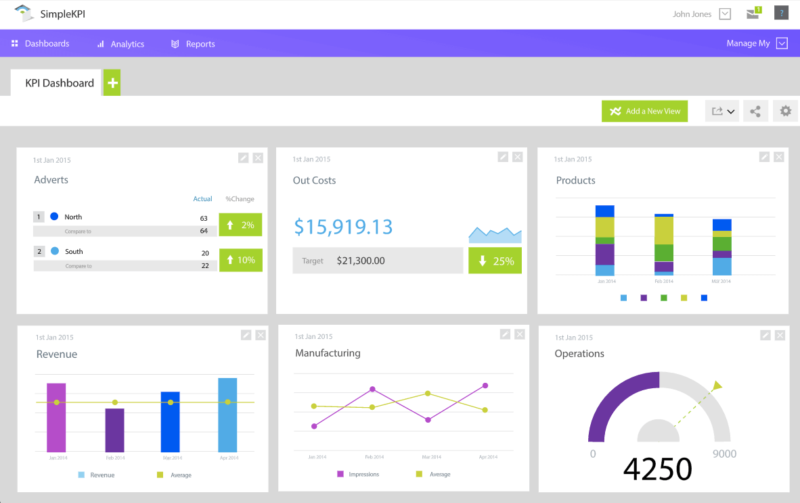
Dashboard Example

Slide 39
Designing performance measurement
systems for operations
Design & test the product or service to maximise customer value and firm profit
Design & test the work process(es) to produce the good or service
Define the value adding activities and processes that compose the process
Develop specific performance measures
Continuously measure to the standard to ensure we are doing what we are intended to do (analysis).

Slide 40
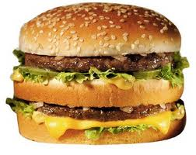
Design & test the product or service to maximise customer value and firm profit
materials & the cooking directions (product layout):
All beef patties x 2
Lettuce x 50g
Cheese x 100g
Pickles x 2
Onions x 1 slice
Sesame seed bun x 1
Sauce x 5ml
Oil for the griddle 10ml
Griddle (heat 200C)
Labour to cook, prepare & serve (20 minutes/burger)
Table service (2 minutes/burger) Service Time Target: 22 minutes

Slide 41
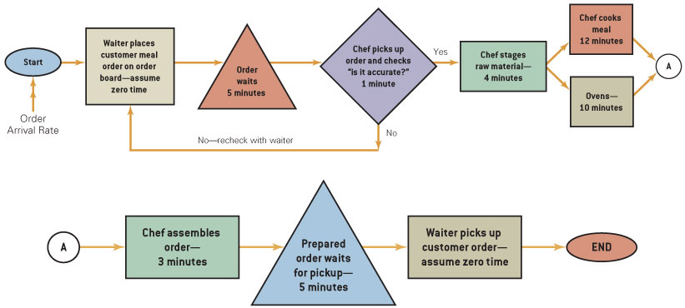
Design & test the work process(es) to produce the good or service
(Collier & Evans 2007; Exhibit 7.9

Slide 42
Develop specific performance measures
Target: 22 minute service time
(Collier & Evans 2007; Exhibit 7.9

Slide 43
Continuously measure to the standard to ensure we are doing what we are intended to do (analysis).
Target: 22 minute service time
28 minute service time
(Collier & Evans 2007; Exhibit 7.9

Slide 44
2. Re-Design & test the product or service to maximise customer value and firm profit
bill of materials & the cooking & service directions (product layout):
All beef patties x 2
Lettuce x 50g
Cheese x 100g
Pickles x 2
Onions x 1 slice
Sesame seed bun x 1
Sauce x 5ml
Oil for the griddle 10ml
Griddle
Labour to cook, prepare & serve (20 minutes/burger)
Table service (2 minutes/burger)
(heat 220C)

Slide 45
Re-Design & test the work process(es) to produce the good or service
(heat 220C)
27 minute service time
(Collier & Evans 2007; Exhibit 7.9

Slide 46
Re-Define the value adding activities and processes that compose the process
(heat 220C)
(Collier & Evans 2007; Exhibit 7.9

Slide 47
Develop specific performance measures
(heat 220C)
17 minute service time
Which exceeds customer expectations > Customer VALUE
(Collier & Evans 2007; Exhibit 7.9

Slide 48
Continuously measure to the standard to ensure we are doing what we are intended to do (analysis).
(heat 220C)
New Standard: 17 minute service time
(Collier & Evans 2007; Exhibit 7.9

Slide 49
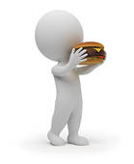

Slide 50
How should we measure the performance of supply chain?
https://www.youtube.com/watch?v=VNK2X4Y1fss

Slide 51
Corporate Social Responsibility and Performance measurement
Purpose of a business is to make a profit
Friedman’s view:
[In a free economy] there is one and only one social responsibility of business – to use its resources and engage in activities designed to increase its profits so long as it stays within the rules of the game, which is to say, engages in open and free competition, without deception or fraud. (1962, 133, quoted in Boddy, 2008, 156).

Slide 52
The Ford Pinto story: (Boddy 2008, 145)
Faulty design of petrol tank
Likely to rupture on rear end impacts with potential injury and death to the occupants
Costs for not fixing the defect: 180 deaths; 180 serious injuries; 2100 vehicles. Unit cost: $200,000 per death; $67,000 per serious injury; $700 per vehicle = $49.551 million
To fix the defect: 11 million cars; 1.5 million light trucks; $11 per car; $11 per truck = $137.5 million
Savings: $87.949 million ! ! !
(137.5 - 49.551 millions)
Is this a misuse of measurement?

Slide 53
References and more information:
Stevenson (2021), Chapter 2
Russell et al. (2017), Chapter 1
Refer to extra references on CANVAS, Topic 3 page (watch video by Prof. Grant on analysing performance)
Notes:
Link: a measurement rule of thumb

Slide 54
The lecture covered:
Organisational and operational strategy & goals
The linkage between organisational, operational strategy(s) & performance measurement systems for products, both goods and services
Measurement systems & Decision Making
Measuring the performance of Goods (key indicators)
Designing measurement/performance systems for operations
Measuring performance across the whole supply chain
Corporate social responsibility and performance measurement

